Slide 1
Buffettology 101
www.glenbradford.com
By Glen Bradford
Warren Buffett in 3 Easy Steps
3. Cheap Price
2. Future Growth
1. Highly Predictable

Slide 2
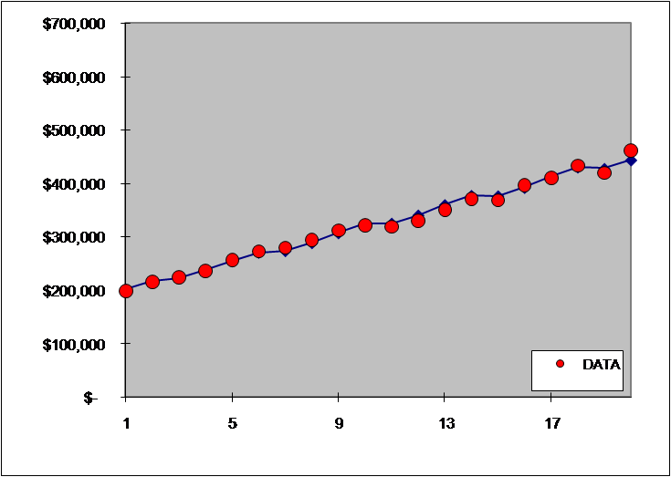
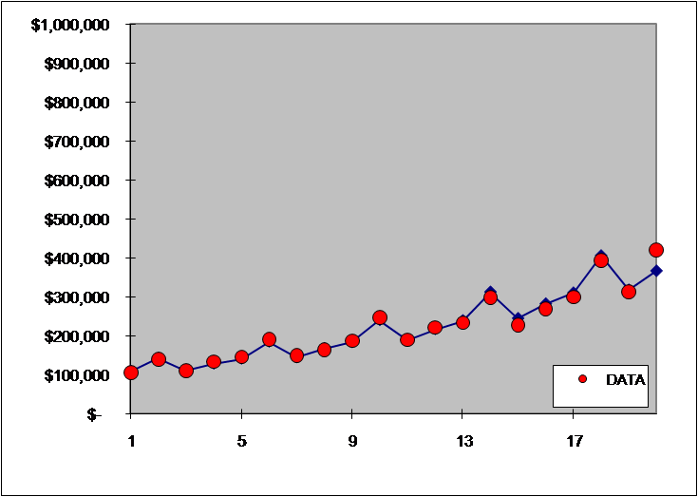
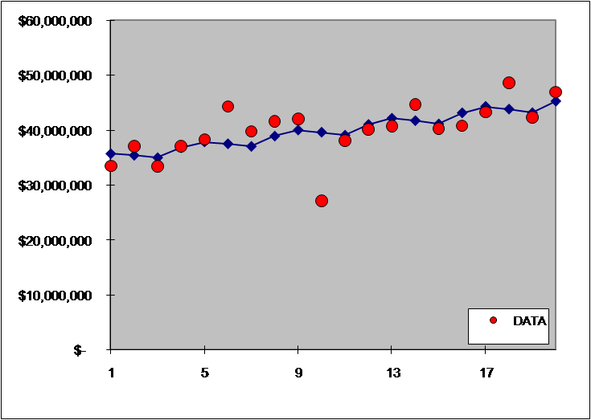
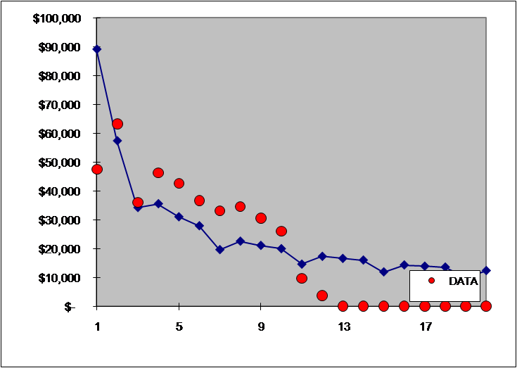
Buffettology 101
www.glenbradford.com
1. Highly Predictable
“Risk comes from not knowing what you're doing.” (Buffet)
.949
.992
.414
.394

Slide 3
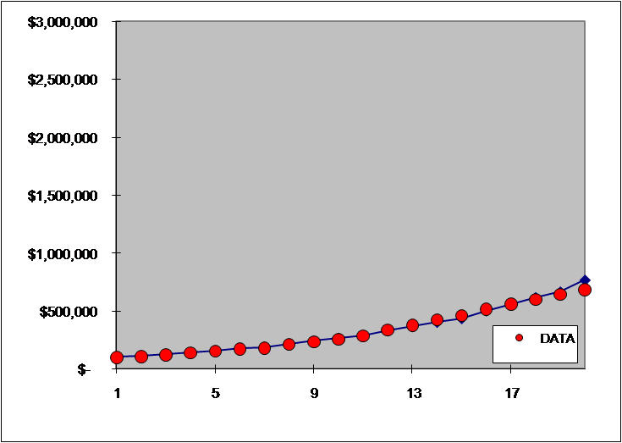
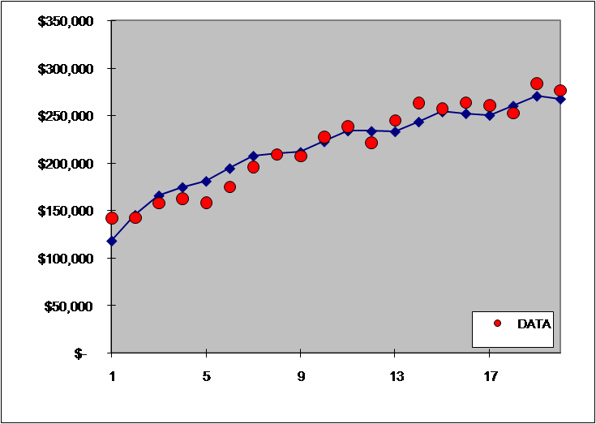
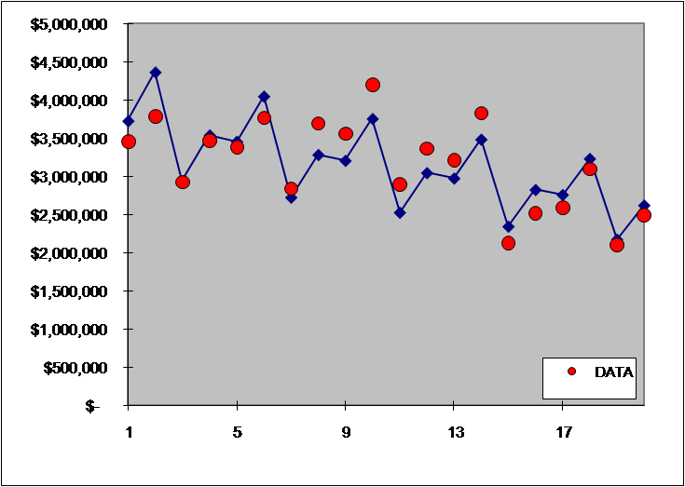
Buffettology 101
www.glenbradford.com
2. Future Growth
“The investor of today does not profit from yesterday's growth.” (Buffet)
.996
.904
.414
.613

Slide 4

Buffettology 101
www.glenbradford.com
3. Current Price
“Price is what you pay. Value is what you get.” (Buffett)
Growth Rate > PE Ratio
PEG Ratio < 1
Rules
of
Thumb
Buffet: Discounted Cash Flow Analysis
Ben Graham Formula
www.glenbradford.com

